Slide 1
VLSI Design & Practice 05
22-bit Carry Save Multiplier
(RCA, SRCSA, 2-stage Pipelined)
Spring semester, 2026
Hyunseok Jung
hsj_@korea.ac.kr
Hyeon-Gwon Kim
gusrnjs48@korea.ac.kr
Jangseok Yu
jangseok@korea.ac.kr
Minjong Yoo
yoom1144@korea.ac.kr

Slide 2
Contents
22×22 Carry Save Multiplier (RC adder)
- Design Carry Save Multiplier with Gate level description
22×22 Carry Save Multiplier (SRCS adder)
- Modify the previous Carry Save Multiplier
2-stage Pipelined 22×22 Carry Save Multiplier (RC adder)
- Design Carry Save Multiplier with Gate level description
Simulation & Synthesis Results
- Check the functionality and Add the flip-flops
- Measure the critical path delay & circuit area
- Check the experimental results (max. clock cycle, area, power )

Slide 3
Contents
22×22 Carry Save Multiplier (RC adder)
- Design Carry Save Multiplier with Gate level description
22×22 Carry Save Multiplier (SRCS adder)
- Modify the previous Carry Save Multiplier
2-stage Pipelined 22×22 Carry Save Multiplier (RC adder)
- Design Carry Save Multiplier with Gate level description
Simulation & Synthesis Results
- Check the functionality and Add the flip-flops
- Measure the critical path delay & circuit area
- Check the experimental results (max. clock cycle, area, power )

Slide 4
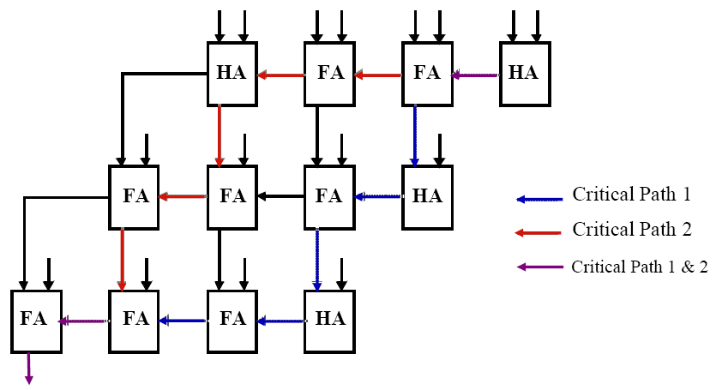

Array Multiplier
Example of 4×4 Array Multiplier
 |  |  |  |  | 1 | 0 | 1 | 0
x |  |  |  |  | 1 | 0 | 1 | 1
 |  |  |  |  | 1 | 0 | 1 | 0
 |  |  |  | 1 | 0 | 1 | 0
 |  |  | 0 | 0 | 0 | 0
+ |  | 1 | 0 | 1 | 0
 | 0 | 1 | 1 | 0 | 1 | 1 | 1 | 0
X₃
X₂
X₁
X₀
Y₀
X₃
X₂
X₁
X₀
Y₁
HA
FA
FA
HA
Z₀
X₃
X₂
X₁
X₀
Y₂
FA
FA
FA
HA
Z₁
X₃
X₂
X₁
X₀
Y₃
FA
FA
FA
HA
Z₂
Z₇
Z₆
Z₅
Z₄
Z₃
Let assume the delay
: HA $≅$ FA

Slide 5

4×4 Carry Save Multiplier
Design 22×22 Carry Save Multiplier ( RC Adder in the last stage )
Ex) 4×4 Carry Save Multiplier
 |  |  |  |  | 1 | 0 | 1 | 0
x |  |  |  |  | 1 | 0 | 1 | 1
 |  |  |  |  | 1 | 0 | 1 | 0
 |  |  |  | 1 | 0 | 1 | 0
 |  |  | 0 | 0 | 0 | 0
+ |  | 1 | 0 | 1 | 0
 | 0 | 1 | 1 | 0 | 1 | 1 | 1 | 0
X₃
X₂
X₁
X₀
Y₀
X₃
X₂
X₁
X₀
Y₁
HA
HA
HA
HA
Z₀
X₃
X₂
X₁
X₀
Y₂
HA
FA
FA
FA
Z₁
X₃
X₂
X₁
X₀
Y₃
HA
FA
FA
FA
Z₂
HA
FA
C_{o}
C_{o}
C_{i}
HA
FA
FA
HA
Z₃
Z₇
Z₆
Z₅
Z₄
Ripple Carry Adder in the last Stage (Vector Merging Adder)

Slide 6



22×22 Carry Save Multiplier
Design 22×22 Carry Save Multiplier ( Ripple Carry Adder in the last stage)
Add flip-flop
at the input / output
FA
Make a 22-bit Array !

Slide 7
Contents
22×22 Carry Save Multiplier (RC adder)
- Design Carry Save Multiplier with Gate level description
22×22 Carry Save Multiplier (SRCS adder)
- Modify the previous Carry Save Multiplier
2-stage Pipelined 22×22 Carry Save Multiplier (RC adder)
- Design Carry Save Multiplier with Gate level description
Simulation & Synthesis Results
- Check the functionality and Add the flip-flops
- Measure the critical path delay & circuit area
- Check the experimental results (max. clock cycle, area, power )

Slide 8
22×22 Carry Save Multiplier
Design 22×22 Carry Save Multiplier (Square Root Carry Select adder )
Ex) 4×4 Carry Save Multiplier
Ex) 4×4 Carry Save Multiplier
X₃
X₂
X₁
X₀
Y₀
X₃
X₂
X₁
X₀
Y₁
HA
HA
HA
HA
Z₀
X₃
X₂
X₁
X₀
Y₂
HA
FA
FA
FA
Z₁
X₃
X₂
X₁
X₀
Y₃
HA
FA
FA
FA
Z₂
HA
FA
FA
HA
Z₃
Z₇
Z₆
Z₅
Z₄
Last stage is still a carry propagation adder !!

Slide 9
22×22 Carry Save Multiplier
Design 22×22 Carry Save Multiplier ( SRCS Adder in the last stage )
Add flip-flop
at the input / output
FA
Make a 22-bit Array !
22-bit Square Root Carry Select Adder

Slide 10
Contents
22×22 Carry Save Multiplier (RC adder)
- Design Carry Save Multiplier with Gate level description
22×22 Carry Save Multiplier (SRCS adder)
- Modify the previous Carry Save Multiplier
2-stage Pipelined 22×22 Carry Save Multiplier (RC adder)
- Design Carry Save Multiplier with Gate level description
Simulation & Synthesis Results
- Check the functionality and Add the flip-flops
- Measure the critical path delay & circuit area
- Check the experimental results (max. clock cycle, area, power )

Slide 11
2-stage Pipelined Carry Save Multiplier
Design 22×22 Carry Save Multiplier ( RC Adder in the last stage )
Ex) 4×4 Carry Save Multiplier
 |  |  |  |  | 1 | 0 | 1 | 0
x |  |  |  |  | 1 | 0 | 1 | 1
 |  |  |  |  | 1 | 0 | 1 | 0
 |  |  |  | 1 | 0 | 1 | 0
 |  |  | 0 | 0 | 0 | 0
+ |  | 1 | 0 | 1 | 0
 | 0 | 1 | 1 | 0 | 1 | 1 | 1 | 0
X₃
X₂
X₁
X₀
Y₀
X₃
X₂
X₁
X₀
Y₁
HA
HA
HA
HA
Z₀
X₃
X₂
X₁
X₀
Y₂
HA
FA
FA
FA
Z₁
X₃
X₂
X₁
X₀
Y₃
HA
FA
FA
FA
Z₂
HA
FA
C_{o}
C_{o}
C_{i}
HA
FA
FA
HA
Z₃
Z₇
Z₆
Z₅
Z₄
Ripple Carry Adder in the last Stage (Vector Merging Adder)

Slide 12
2-stage Pipelined Carry Save Multiplier
Design 22×22 Carry Save Multiplier ( Ripple Carry Adder in the last stage)
Add flip-flop
at the input / output
FA
Make a 22-bit Array !
Add 2-stage
pipelining flip-flop
Why?
Check paths
22-bit Ripple Carry Adder !

Slide 13
Contents
22×22 Carry Save Multiplier (RC adder)
- Design Carry Save Multiplier with Gate level description
22×22 Carry Save Multiplier (SRCS adder)
- Modify the previous Carry Save Multiplier
2-stage Pipelined 22×22 Carry Save Multiplier (RC adder)
- Design Carry Save Multiplier with Gate level description
Simulation & Synthesis Results
- Check the functionality and Add the flip-flops
- Measure the critical path delay & circuit area
- Check the experimental results (max. clock cycle, area, power )

Slide 14
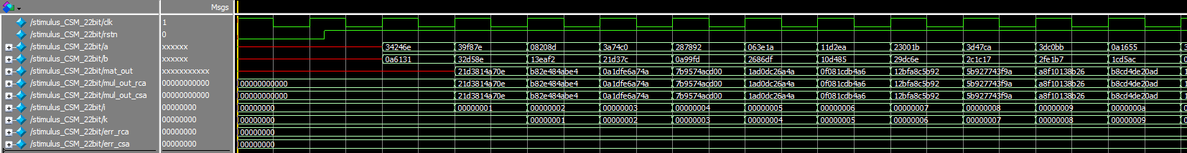
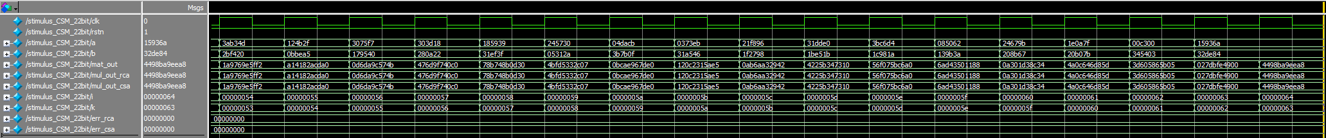
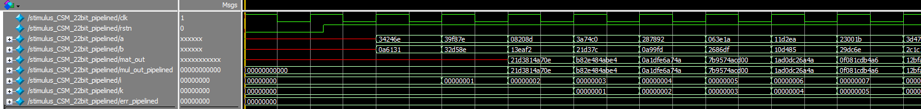
Functional Verifications
Simulation results
- Check outputs of two multipliers and Matlab results are ‘same’
- Check the value of error counting number equals ‘zero’
- Check the delay for 2-stage pipelined multiplier

Slide 15
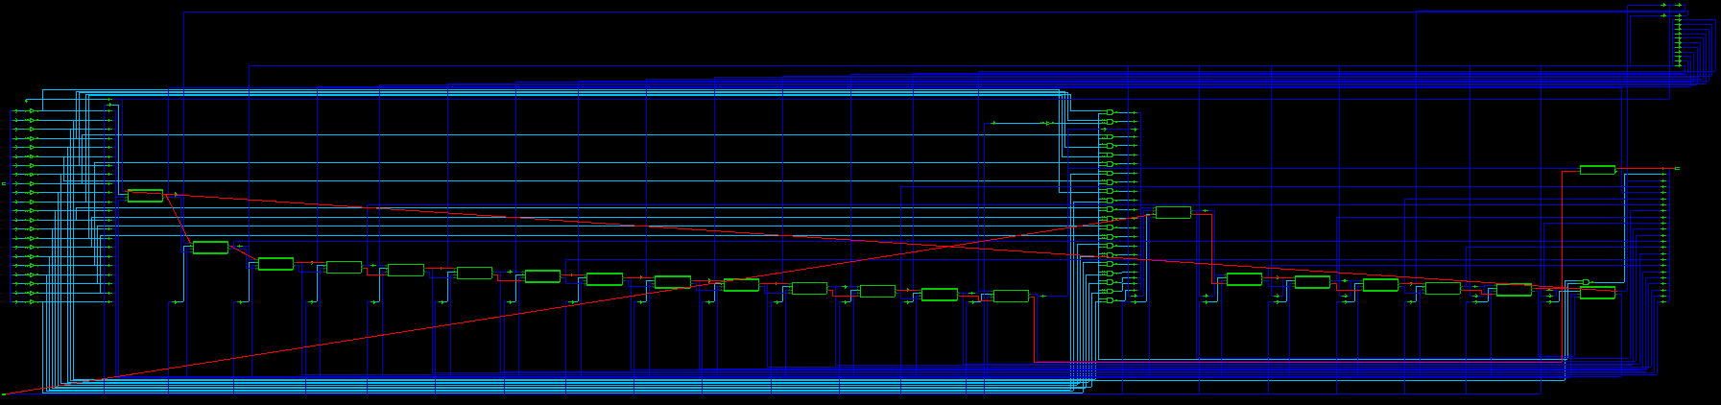
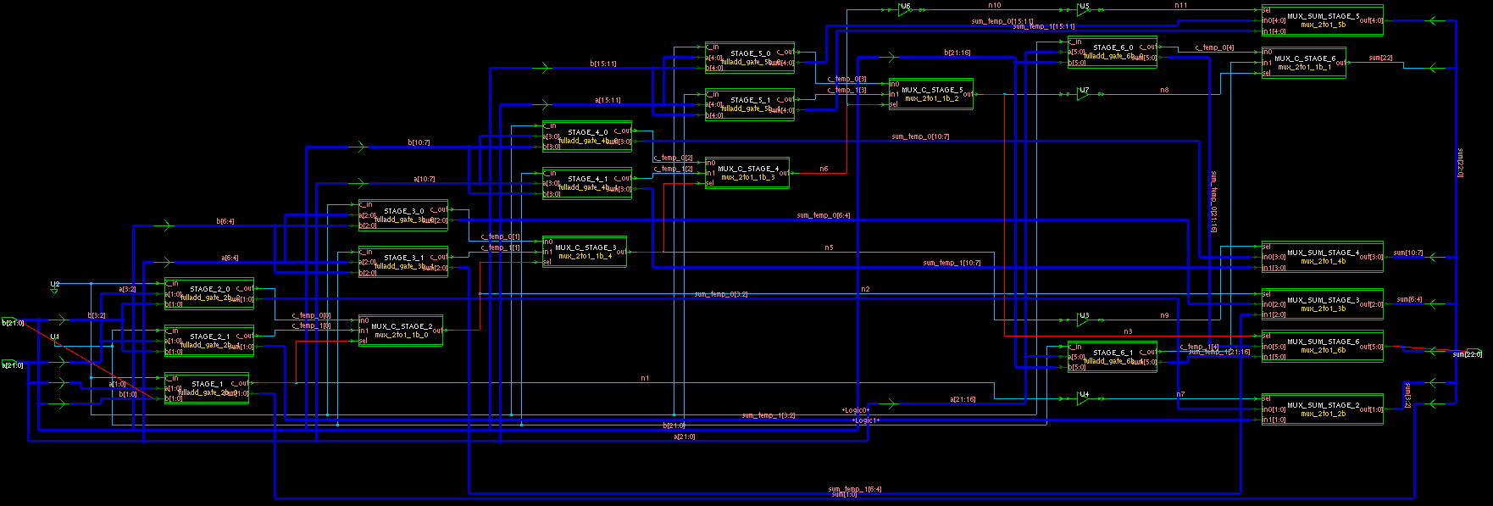
Find the maximum clock cycle
Synthesis results Carry Select Multipiler with SRCS adder
- Check positions and names of each modules and find critical paths.

Slide 16
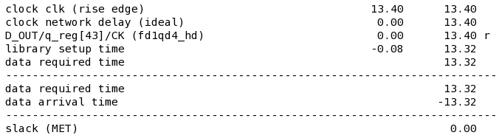
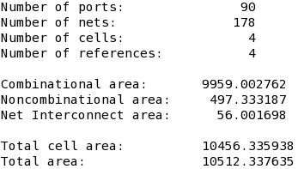
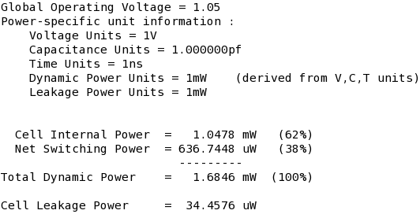
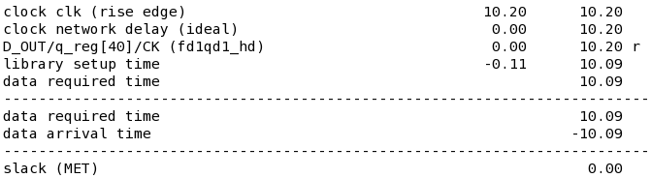
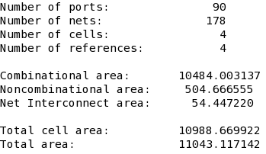
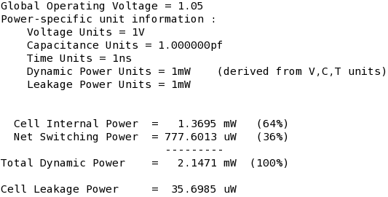
Check the synthesis results
Critical path delay, Circuit area & Power
report_timing
report_area
report_power
RCadder
RCadder
RCadder
SRCSadder
SRCSadder
SRCSadder

Slide 17
Check results and Submit report
Check the synthesis result
Show waveforms & synthesis results (schematic)
Show timing, area, power report & .v file
Check the highlighted critical path
Submit result report
- Show the timing diagram and the above synthesis results
- Results analysis
Due : Before the next class to your group TA
(담당 조교에게 제출 바랍니다)

